Slide 1
Loan Default Prediction
EC 48W - Data Driven Decision Making
Denizhan Özyurt
Ezgi Berksoy
Ozan Yagcilar
Ömer Bahar
Zeki Berkay Saygin

Slide 2


The Source of the Data
We are using a competition data from Kaggle published by Imperial College London
We are asked to determine whether a loan will default, and what will be the loss incurred if it’s a default
Link to the competition

Slide 3
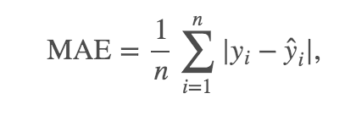
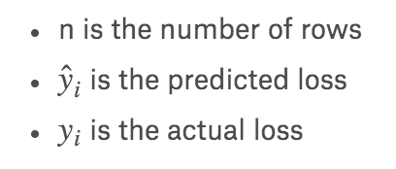
Objective of the competition
Losses are represented as values between 0-100. So this also captures the probability of a default and the loss at default at the same time.
Competition wants us to minimize the mean absolute error, but we will only model the probability of default.

Slide 4
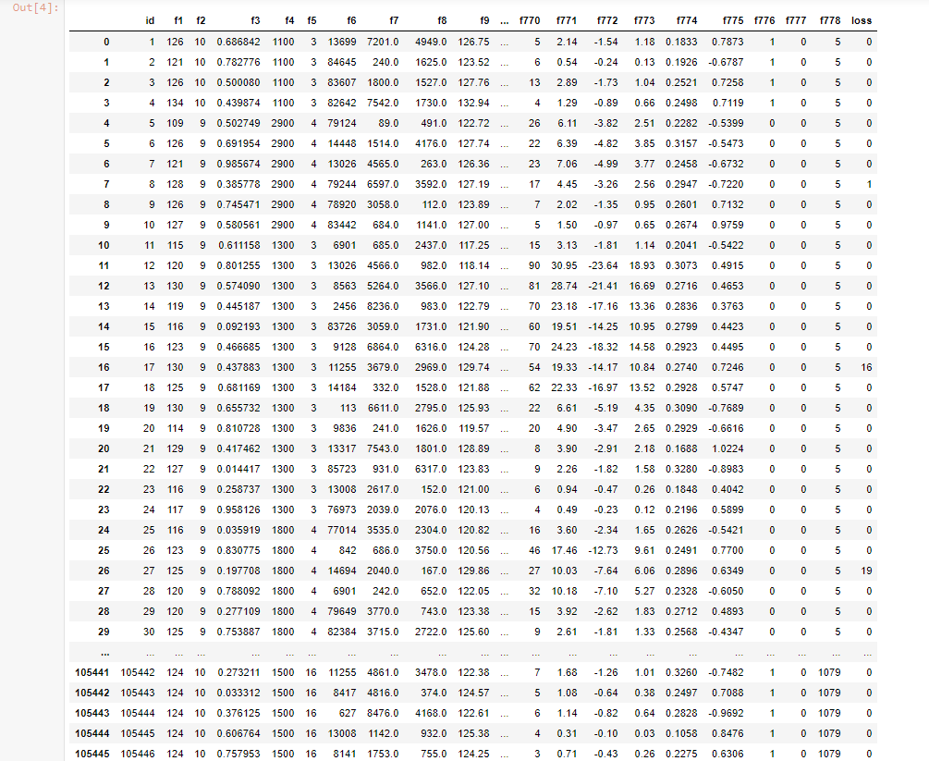
Aggregate look to the data after importing it

Slide 5
Statistical exploration of features
In our dataset we have 105,471 independent observations
For each observation we have 780 columns;
ID number which are chronologically ordered
778 parameters, There are both descriptive and categorical variables (all features are anonymised, standardised and de-trended)
Losses which are represented as normalized form in 0-100 (0 means no default, values between 0 and 100 represents percentage of loss)
So we have 82.2M cells of data from 105,471 x 780

Slide 6
Statistical exploration of features
For 105,471 observations we have calculated
Count
Mean
Standard Deviation
Min
25%
50% (Median)
75%
Max

Slide 7
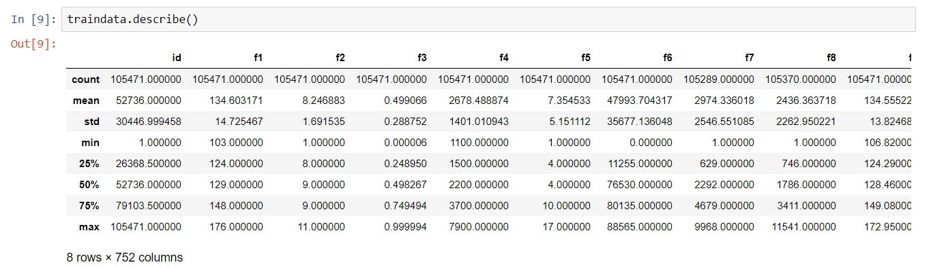
Statistical exploration of features

Slide 8
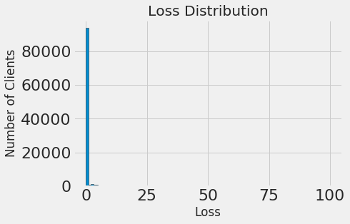
Histogram of Losses (y-value)

Slide 9
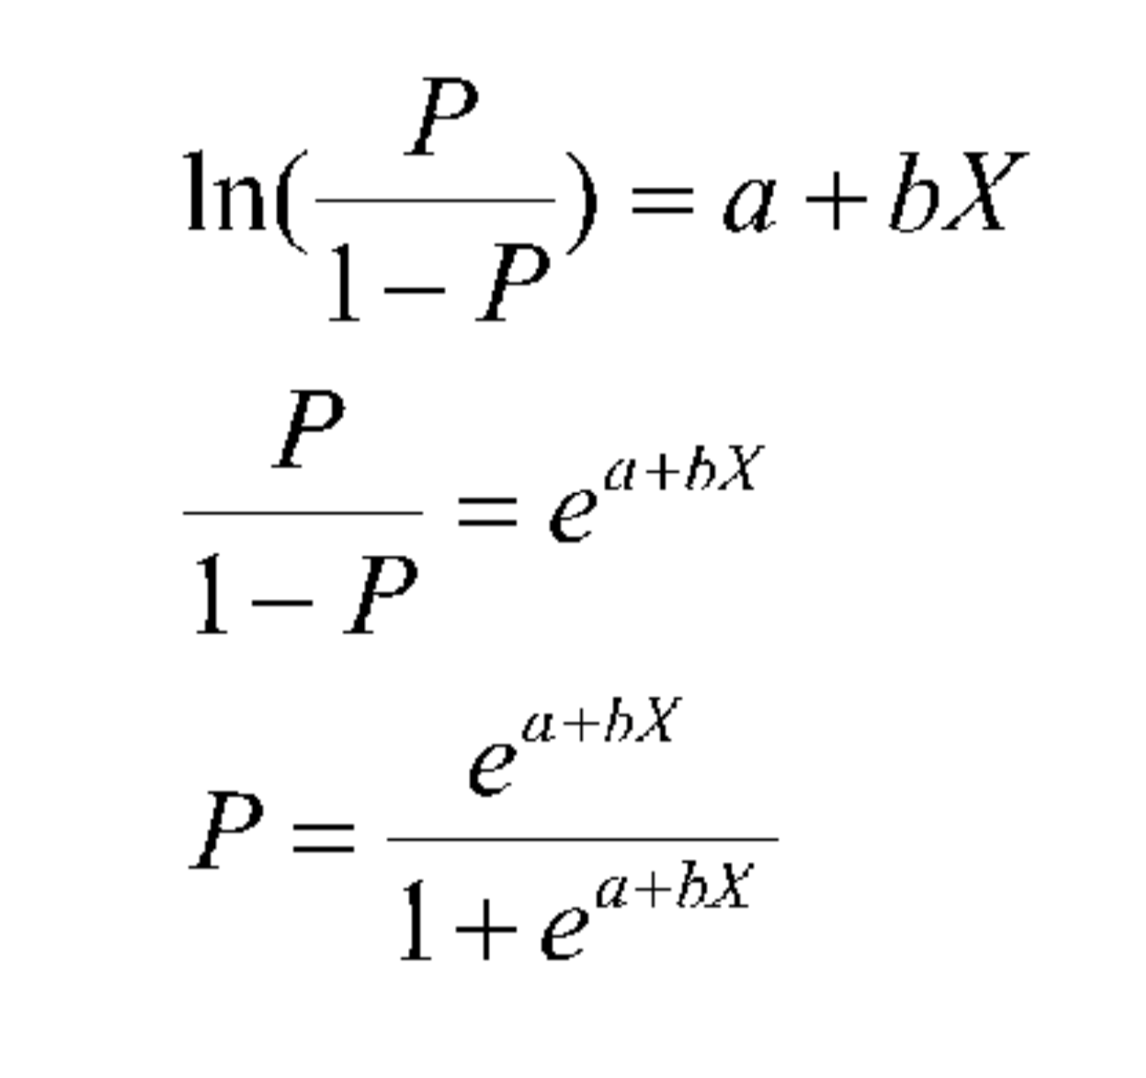
ML method we are going to use and details
The model we are going to apply to complete machine learning process is Logistic Regression.
In this model, we are going to classify whether the credit will default or not. We will end up with binary results.
Non linear Transformation Logistic Regression (Logit)
We will use the library XgBoost to obtain a gradient boosting
framework.

Slide 10
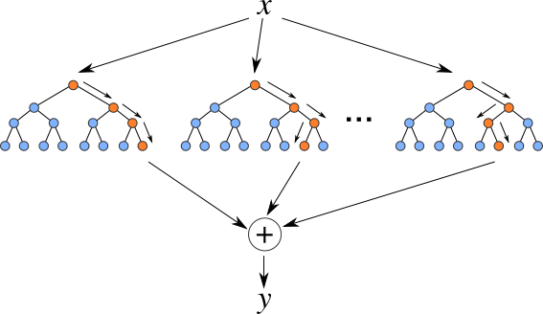
How are we going to employ
The machine learning algorithm we are going to use is “Random Forest”.
This algorithm can be used for both classification and regression that is why it forms the majority of the current machine learning systems.
The random forest model is a type of additive model that makes predictions by combining decisions from a sequence of base models.
Random Forests grows many classification trees.

